Slide 1
Introduction to Machine Learning
MIT Quantitative Methods Workshop, 2022
Taylor Baum

Slide 2
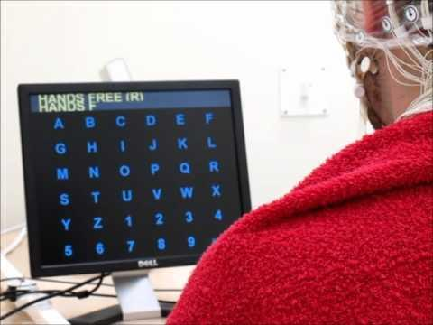

Slide 3
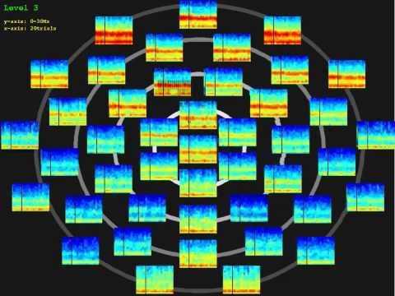

Slide 4
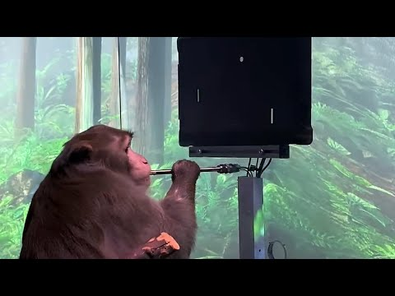

Slide 5
Today, we are going to get introduced to machine learning, and then apply it to neuroscience data.

Slide 6
What is Machine Learning?

Slide 7
An algorithm is similar to a recipe.
Preheat oven to 375 degrees F.
Line a baking pan with parchment paper and set aside.
In a separate bowl mix flour, baking soda, salt, baking powder. Set aside.
Cream together butter and sugars until combined.
...

Slide 8
More formally, an algorithm is a process or set of rules with which a task is completed or with which an input is manipulated to produce an output.
if x
do y;
if else z
do a;
else
break;

Slide 9
For example, we use algorithms for tasks like sorting.
Input: Unsorted Numbers
Algorithm?
Output: Sorted Numbers

Slide 10
What if there is a task where the algorithm isn’t obvious?
Input: Emails
Algorithm?
Output: Indication of Spam (Yes/No)

Slide 11
What can we do?
Input: Emails
Algorithm?
Output: Indication of Spam (Yes/No)

Slide 12
Well, we often have a large amount of data that we can use to help inform how we produce appropriate outputs from these inputs.
DATA

Slide 13
Machine Learning provides automated methods of data analysis that can then be used further.
Input: Emails
Algorithm?
Output: Spam (Yes/No)

Slide 14
Machine Learning provides automated methods of data analysis that can then be used further.
Input: Emails
DATA
Approximate Model
Output: Spam (Yes/No)

Slide 15
Machine Learning is a set of methods that can automatically detect patterns in data, and then use the uncovered patterns to predict future data, or to perform other kinds of decision making under uncertainty.
Notes:
Murphy, Kevin P.. Machine Learning: A Probabilistic Perspective, MIT Press, 2012. ProQuest Ebook Central, http://ebookcentral.proquest.com/lib/pensu/detail.action?docID=3339490.

Slide 16
So, we want to learn the patterns or approximate models from the data, and then use that approximate model to make predictions on new data.
Input: Emails
DATA
Approximate Model
Output: Spam (Yes/No)

Slide 17
Where did the idea for Machine Learning come from?

Slide 18
Traditionally, humans learn how to do certain tasks from experience in the real-world while computers must be instructed to do things.
Learn From Experience
Do By Instruction
Notes:
Example:
Picking up a glass
Walking

Slide 19
Machine learning is a field which seeks to enable computers and machines to learn from experience.
Learn From Experience
Instructed to Learn From Experience
Do By Instruction

Slide 20
The experience that computers have access to is known as data.
Learn From Experience
Instructed to Learn From Data
Do By Instruction

Slide 21
Thus far, there are three different ways that a machine can learn. We will focus on 1, and 2.
Supervised Learning
1.
Unsupervised Learning
2.
Reinforcement Learning
3.

Slide 22
Supervised learning uses labeled data as it’s feature set, or the data we initially have to learn patterns from.
Supervised Learning
1.

Slide 23
The labeled data is a set of input-output pairs.
Supervised Learning
1.

Slide 24
For example...
X
Y
Notes:
Input: Matrix of Pixel Values
Output: Vector of ones and zeros where a location in the vector is 1 corresponding to cat

Slide 25

For example...
Notes:
Input: Matrix of Pixel Values
Output: Vector of ones and zeros where a location in the vector is 1 corresponding to cat

Slide 26
For example...
evil
Notes:
Input: Matrix of Pixel Values
Output: Vector of ones and zeros where a location in the vector is 1 corresponding to cat

Slide 27
For example...
cat
Notes:
Input: Matrix of Pixel Values
Output: Vector of ones and zeros where a location in the vector is 1 corresponding to cat

Slide 28
In other words, you have input variables (X) and their corresponding output variables (Y) and you want to learn the mapping between these variables.
Supervised Learning
1.

Slide 29
Unsupervised learning uses unlabeled data as it’s feature set, or the data we initially have to learn patterns from.
Unsupervised Learning
2.

Slide 30
In unsupervised learning, we only have a set of inputs, and the goal is to discover interesting patterns in the data.
Unsupervised Learning
2.

Slide 31
We will look at examples of both of these learning techniques!
Supervised Learning
1.
Unsupervised Learning
2.

Slide 32
What are some achievements which have arisen from Machine Learning?

Slide 33
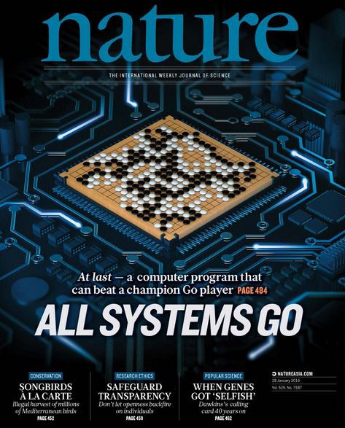
What are some achievements which have arisen from Machine Learning?
Alpha Go
Notes:
Resources:
https://deepmind.com/research/alphago/

Slide 34
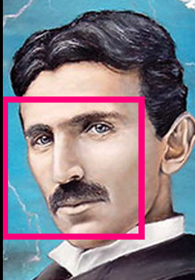
What are some achievements which have arisen from Machine Learning?
Face Detection
Notes:
Resources:
https://assetstore.unity.com/packages/tools/integration/face-detection-lib-face-tracking-sdk-quantum-vision-72408

Slide 35
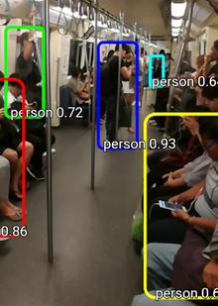
What are some achievements which have arisen from Machine Learning?
Object Detection
Notes:
Resources:
https://apkpure.com/object-detection-and-classification-tensorflow/hash.tf.objectdetection

Slide 36
In the past three examples, we saw that these tasks are complex, like a game with many rules.

Slide 37
Before Machine Learning approaches, progress towards achieving these tasks was minimal.

Slide 38
What data could have been used for the previous examples?

Slide 39
What data could have been used for the previous examples?
Face Detection
Notes:
Resources:
https://assetstore.unity.com/packages/tools/integration/face-detection-lib-face-tracking-sdk-quantum-vision-72408
Answer:
A set of labeled images of faces

Slide 40
What data could have been used for the previous examples?
Alpha Go
Notes:
Resources:
https://deepmind.com/research/alphago/
Answer:
A set of descriptions of previous games that have been played

Slide 41
What data could have been used for the previous examples?
Object Detection
Notes:
Resources:
https://apkpure.com/object-detection-and-classification-tensorflow/hash.tf.objectdetection
Answer:
A set of photos with labels that indicate where people are in said photos

Slide 42
Machine learning is a field which seeks to enable computers and machines to learn from experience or data.

Slide 43
Machine Learning is a set of methods that can automatically detect patterns in data, and then use the uncovered patterns to predict future data, or to perform other kinds of decision making under uncertainty.
Notes:
Murphy, Kevin P.. Machine Learning: A Probabilistic Perspective, MIT Press, 2012. ProQuest Ebook Central, http://ebookcentral.proquest.com/lib/pensu/detail.action?docID=3339490.

Slide 44
How do we learn from data?

Slide 45
Say we have data points associated with the following graph below.
250
200
Price ($1000)
150
100
50
25
50
75
100
125
150
175
200
House Size (100 sq ft.)

Slide 46
Is there a trend in this data? If so, what is it?
250
200
Price ($1000)
150
100
50
25
50
75
100
125
150
175
200
House Size (100 sq ft.)

Slide 47
How might a computer learn this trend from these data points?
250
200
Price ($1000)
150
100
50
25
50
75
100
125
150
175
200
House Size (100 sq ft.)

Slide 48
Least Squares Linear Regression (LSLR)

Slide 49
First, the computer makes a guess.
250
200
Price ($1000)
150
100
50
25
50
75
100
125
150
175
200
House Size (100 sq ft.)

Slide 50
Then it checks its error metric; it wants to know how bad its guess performs with the given data.
250
200
Price ($1000)
150
100
50
25
50
75
100
125
150
175
200
House Size (100 sq ft.)

Slide 51
What could the error metric be?
250
200
Price ($1000)
150
100
50
25
50
75
100
125
150
175
200
House Size (100 sq ft.)

Slide 52
A first guess may be distance from each data point.
250
200
Price ($1000)
150
100
50
25
50
75
100
125
150
175
200
House Size (100 sq ft.)

Slide 53
How would we account for negative distances?
250
200
Price ($1000)
150
100
50
25
50
75
100
125
150
175
200
House Size (100 sq ft.)

Slide 54
We use the mean squared distance of a data point from the guess.
250
200
Price ($1000)
150
100
50
25
50
75
100
125
150
175
200
House Size (100 sq ft.)

Slide 55
Guess 1
250
200
Price ($1000)
150
100
50
25
50
75
100
125
150
175
200
House Size (100 sq ft.)

Slide 56
Guess 1
Guess 2
250
200
Price ($1000)
150
100
50
25
50
75
100
125
150
175
200
House Size (100 sq ft.)

Slide 57
Guess 1
Guess 2
Guess 3
250
200
Price ($1000)
150
100
50
25
50
75
100
125
150
175
200
House Size (100 sq ft.)

Slide 58
The algorithm will make guesses, calculate the error for each data point at each guess, and try to minimize it until it reaches the minimum mean square error.
250
200
Price ($1000)
150
100
50
25
50
75
100
125
150
175
200
House Size (100 sq ft.)

Slide 59
This is known as the training phase.
250
200
Price ($1000)
150
100
50
25
50
75
100
125
150
175
200
House Size (100 sq ft.)

Slide 60
The algorithm is programmed to decrease the mean square error over many iterations.
Mean Square Error
Guess

Slide 61
This is a simple example of gradient descent.
Mean Square Error
Guess
Notes:
Great resource to learn more about gradient descent: https://towardsdatascience.com/linear-regression-using-gradient-descent-97a6c8700931

Slide 62
What is learned in LSLR?
Notes:
Answer:
The slope and y-intercept of the line.

Slide 63
How does it do this?
Notes:
Answer:
Iteratively minimizing the mean square error

Slide 64
What type of learning is this?
Notes:
Answer:
Supervised

Slide 65
Now, we can use the learned parameters to estimate the price of a house size where we don’t have an observation for that house size.
250
200
Price ($1000)
150
100
50
25
50
75
100
125
150
175
200
House Size (100 sq ft.)

Slide 66
Now, we can use the learned parameters to estimate the price of a house size where we don’t have an observation for that house size.
250
200
Price ($1000)
150
100
50
25
50
75
100
125
150
175
200
House Size (100 sq ft.)

Slide 67
What if we would like to determine whether or not our model was a good model?
250
200
Price ($1000)
150
100
50
25
50
75
100
125
150
175
200
House Size (100 sq ft.)

Slide 68
We can check to see how good our parameter fit is by checking other data observations that we may have left out of the set.
250
200
Price ($1000)
150
100
50
25
50
75
100
125
150
175
200
House Size (100 sq ft.)

Slide 69
This is called the test phase.
250
200
Price ($1000)
150
100
50
25
50
75
100
125
150
175
200
House Size (100 sq ft.)

Slide 70
Generalizability can be defined as the extension of research findings and conclusions from a study conducted on a sample set to a larger data set.
250
200
Price ($1000)
150
100
50
25
50
75
100
125
150
175
200
House Size (100 sq ft.)

Slide 71
Overfitting is when you train a model and it fits the given data extremely well but fails when new data outside of the training set is introduced.
250
200
Price ($1000)
150
100
50
25
50
75
100
125
150
175
200
House Size (100 sq ft.)

Slide 72
If we relax the constraint that we are training a linear model, we can illustrate what overfitting might look like.
250
200
Price ($1000)
150
100
50
25
50
75
100
125
150
175
200
House Size (100 sq ft.)

Slide 73
In this case, why do we know that this is less desirable than a linear model?
250
200
Price ($1000)
150
100
50
25
50
75
100
125
150
175
200
House Size (100 sq ft.)

Slide 74
Generalizability is pivotal for a model to be useful.
250
200
Price ($1000)
150
100
50
25
50
75
100
125
150
175
200
House Size (100 sq ft.)

Slide 75
Machine Learning is a set of methods that can automatically detect patterns in data, and then use the uncovered patterns to predict future data, or to perform other kinds of decision making under uncertainty.
Notes:
Murphy, Kevin P.. Machine Learning: A Probabilistic Perspective, MIT Press, 2012. ProQuest Ebook Central, http://ebookcentral.proquest.com/lib/pensu/detail.action?docID=3339490.

Slide 76
Tutorial: Linear Least Squares Regression

Slide 77
Let’s assess our understanding with some some awesome applications of Machine Learning in Neuroscience!

Slide 81
K-means Clustering

Slide 82
K-means clustering is an unsupervised learning example and is also used to classify data.

Slide 83
The ultimate goal is to partition the given data into a few groups or clusters.

Slide 84
What are some examples of where clustering might be useful?
Notes:
Example Answer:
Diagnostics

Slide 85
The way that this algorithm learns the appropriate clusters is by placing centroids randomly on the graph, calculating the distance of each point to its closest centroid, recomputing the centroid as the mean of all points and then iterating.

Slide 86
Let us visualize this training procedure.

Slide 87
Let us visualize this training procedure.

Slide 88
Let us visualize this training procedure.

Slide 89
Let us visualize this training procedure.

Slide 90
The number of centroids is a user-prescribed parameter.

Slide 91
The number of centroids is a user-prescribed parameter.

Slide 92
What is being learned here?
Notes:
Answer:
It is labelled.

Slide 93
Is K-means supervised or unsupervised?
Notes:
Answer:
It is labelled.

Slide 94
Machine Learning and Biology

Slide 95
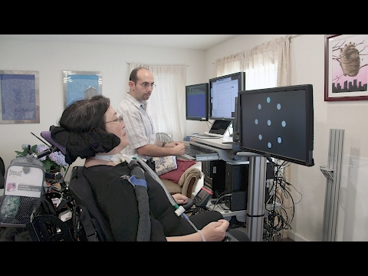
One of my favorite applications of machine learning to neuroscience is that which is done with brain-computer interface research.

Slide 96
How might machine learning be used in this case?

Slide 97
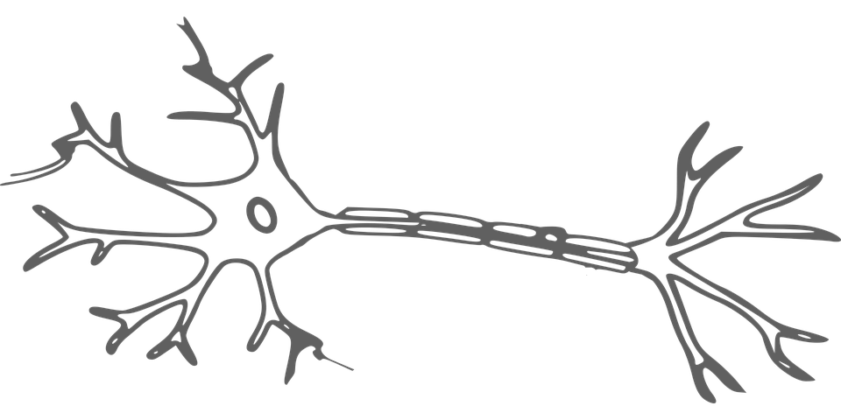
What do we know about neuroscience?
Notes:
Resources:
https://pixabay.com/en/brain-neuron-nerves-cell-science-2022398/

Slide 98
An important concept is that of individual neurons and their electrical signals.
Notes:
Resources:
https://pixabay.com/en/brain-neuron-nerves-cell-science-2022398/

Slide 99
In single cell electrical signals, we look at action potentials, so our signals look like spikes.
Notes:
Resources:
https://pixabay.com/en/brain-neuron-nerves-cell-science-2022398/

Slide 100
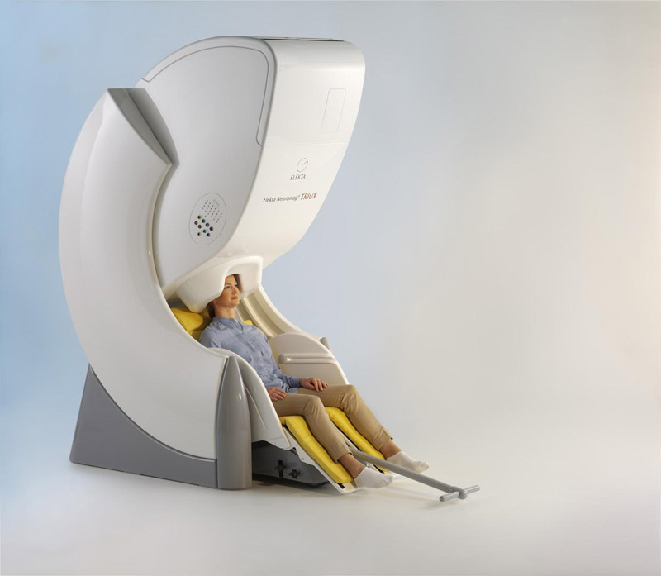
In this experiment, we are using an MEG, which is a huge machine that measures the magnetic activity of neurons.

Slide 101
Let’s do a bit of review to begin to understanding what it means to read magnetic signals from the brain.

Slide 102
First, let’s think about voltage and current.
V = IR
Voltage = Current * Resistance

Slide 103
First, let’s think about voltage and current.
V = IR

Slide 104
First, let’s think about voltage and current.
V = IR

Slide 105
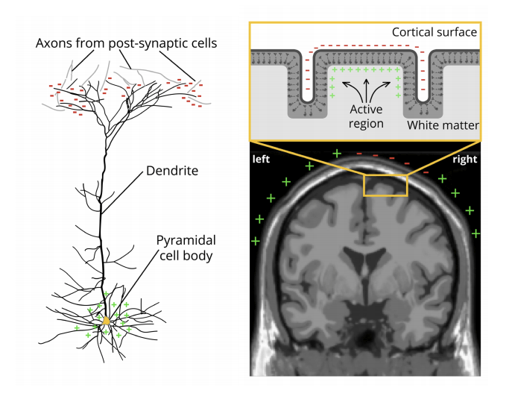
There are voltage sources in the brain which we can look at with noninvasive techniques.
Notes:
https://imotions.com/blog/eeg/

Slide 106
Research indicates that it is primarily the synchronized activity of pyramidal neurons in cortical brain regions which can be measured from the outside.
Notes:
https://imotions.com/blog/eeg/

Slide 107
This is because pyramidal neurons are oriented together, and there are a bunch of them we can actually read these synchronous signals through the scalp and bone and things!
Notes:
https://imotions.com/blog/eeg/

Slide 108
So instead of single neuron recordings, we look at the summed activity of many pyramidal neurons.
Notes:
https://imotions.com/blog/eeg/

Slide 109
So instead of single neuron recordings, we look at the summed activity of many pyramidal neurons.
Notes:
https://imotions.com/blog/eeg/

Slide 110
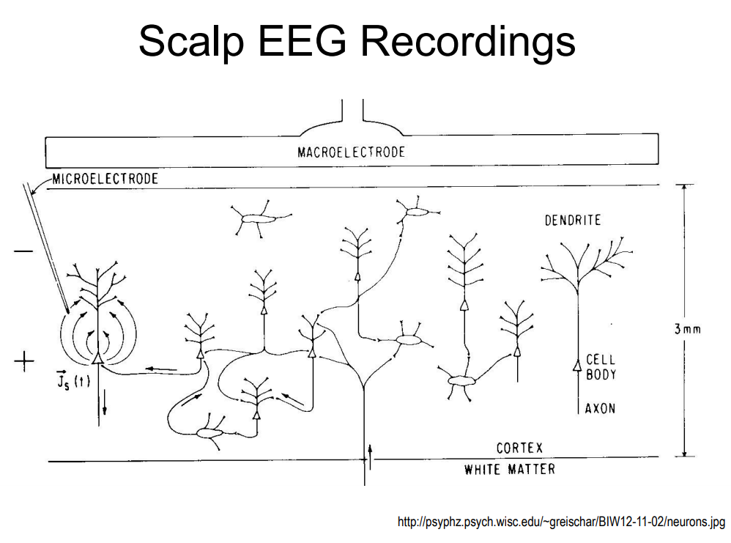
So instead of single neuron recordings, we look at the summed activity of many pyramidal neurons.

Slide 111
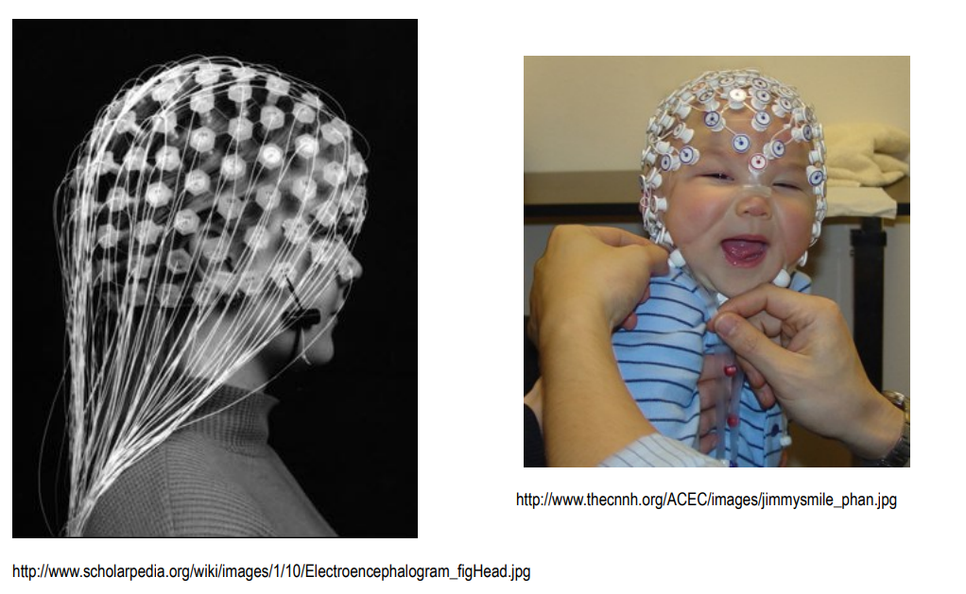
Electroencephalography (EEG) looks like this!
Notes:
https://imotions.com/blog/eeg/

Slide 112
Where the heck does a magnetic field come in?

Slide 113
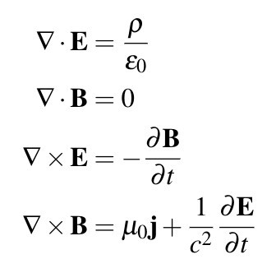
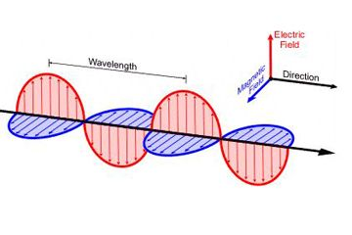
Maxwell’s equations: changing magnetic fields produce electric fields

Slide 114
The Experimental Setup

Slide 115
In our experiment we have..
306 sensors
25 different scene images
5 different scene categories

Slide 116
We want to see if we can identify when someone is viewing each scene category, such that we could predict the categories of MEG data from new trials.

Slide 117
If we can do this, this means that the brain is encoding the visual stimuli in a way that is decodable by MEG signals.

Slide 118
If we cannot do this, however, it does NOT mean that the brain is not encoding this information. Why?
Notes:
Because the brain can still be encoding the information in a way that we cannot observe with MEG.

Slide 119
Tutorial: K-Means

Slide 120
Today, we are going to get introduced to machine learning, and then apply it to neuroscience data.

Slide 121
Thanks!

Slide 122
Appendix

Slide 123
Support Vector Machine

Slide 124
SVMs are a supervised learning example and are used to classify data.

Slide 125
If this is supervised learning, what does that mean about the input data?
Notes:
Answer:
It is labelled.

Slide 126
Instead of simply separating the data, it tries to maximize the margin (indicated by the double arrow below) of each of the closest data points to the separating line.

Slide 127
SVMs do this in a similar way to the method used for the parameters of our linear regression example.

Slide 128
A vector describes a point in space by its direction and magnitude. What is the magnitude of this vector?
(2, 1)
Notes:
Answer:
Square root of 5

Slide 129
This method is called a SVM because the solution only really depends on the points that define the margin or the support vectors.

Slide 130
Support vectors are the data points which lie closest to the decision surface.

Slide 131
Here, I have illustrated the actual support vectors, but often just the points are referenced instead.

Slide 132
What is being learned here?
Notes:
Answer:
It is labelled.

Slide 133
What is the difference of the goal of LSLR versus SVM?
Notes:
Answer:
It is labelled.

